Slide 1


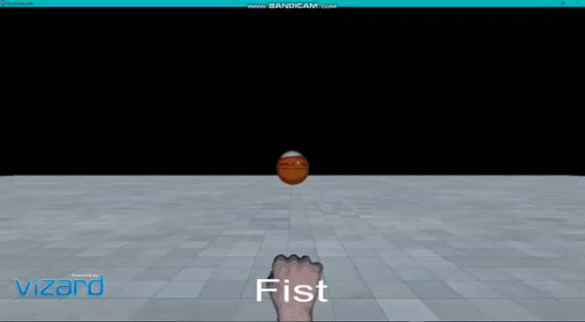
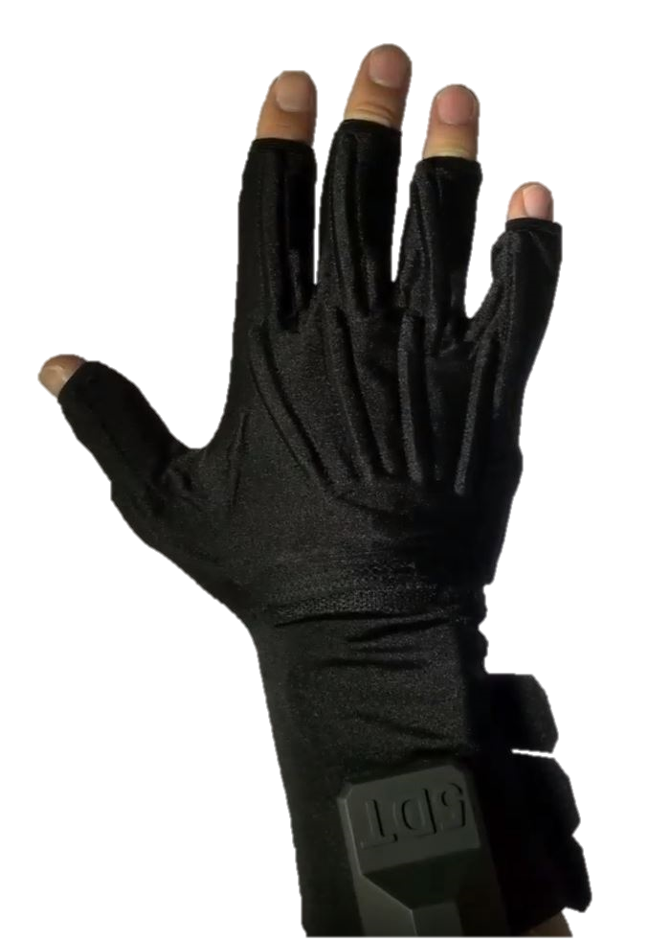
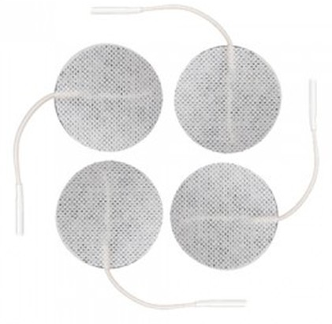
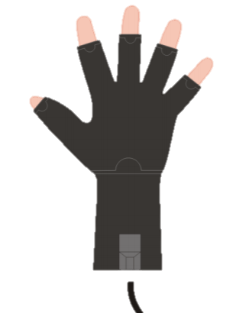
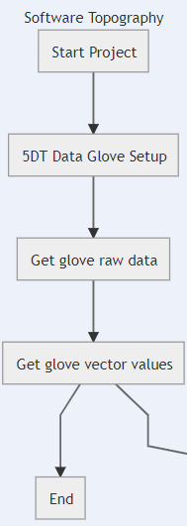
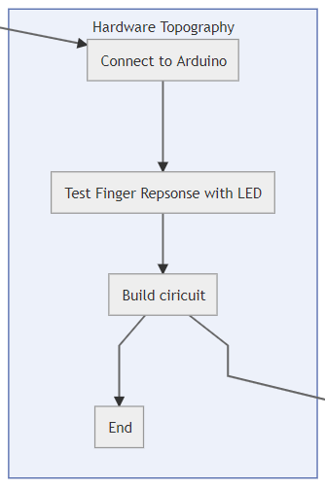
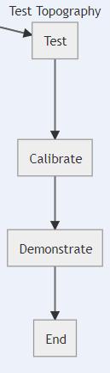
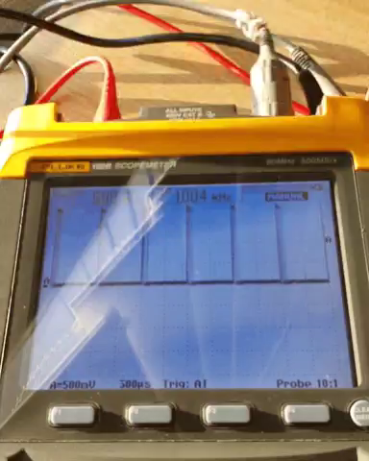
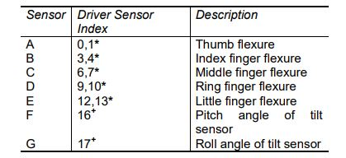
Arduino-based Electrotactile Simulation System for Virtual Sensory Contact
Student: Javan Willock
Supervisor: Francisco Sepulveda
Introduction
Method and Tools
Current Implementation
Current Implementation cont.
This project aims to achieve obstacle detection in a virtual environment with the aid of electrodes, electro-tactile stimulation and a data glove.
Electrode – Delivers tactile sensation to the fingertips.
Waveform generator - Provides stimulation within specified parameters.
PCB – Connects glove, Arduino and electrodes to one another.
Vizard5 – Virtual Reality Software with Python scripting capabilities.
Glove Script
Goals
Arduino
To recreate the sense of contact made with touching an obstacle in the 3D environment. This will be achieved by delivering localised stimulation to the tips of the wearers fingertips.
Waveform Generator
Voltage-to-current-converter
Hand model in virtual world
Difficulties
1
2
3
Electrodes
Creating electrode stimulation for sensory feedback. Currently working on implementing a basic feedback strong enough to feel on the human fingertip.
Software Topography
Basic top-level circuit hierarchy
Hardware Topography
Test Topography
Next Steps
Self adhesive
electrodes
Data Glove
Completion of feedback system, by creation of the main voltage-to-current converter and linking this with the python script for the glove. And then testing of system on willing participants. Users will be put through a small trial run, where waveform parameters will be altered and sensitivity to the electrodes will be recorded.
Project Diagram
Sensor mappings table
PWM output from circuit

